Slide 1

Welcome to our presentation on
Network Programming Project

Slide 2
Course no: CSE 425
Course title: Network Programming
Group members:-
Sadia Jahan (ID: 11.01.04.157)
Israt Jahan (ID: 11.01.04.163)
Farjana Akhter Ebha (ID: 11.01.04.168)

Slide 3
Project Title
Web Hospital

Slide 4
MOTIVATION
Our country does not possess sufficient hospitals or doctors for its habitants.
Results hazardous situation when one wants to admit in hospitals or want to take appointment
Often people want to know who the available doctor in specific hospitals are
Current process leads to unnecessary time wastage, man power and often confusion regarding serials

Slide 5
USED TECHNOLOGY
Java
Servlet
Web Container
Database (MySql)
JDBC
PHP
Xampp

Slide 6
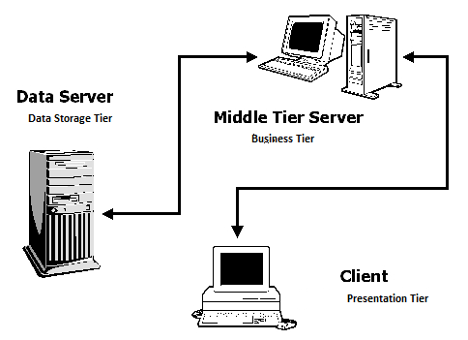
APPLICATION ARCHITECTURE

Slide 7
APPLICATION ARCHITECTURE(CONT.)
In our project we use 3 tier architecture.
They are:
Presentation Tier
Business Tier:
Data Logic Tier:

Slide 8
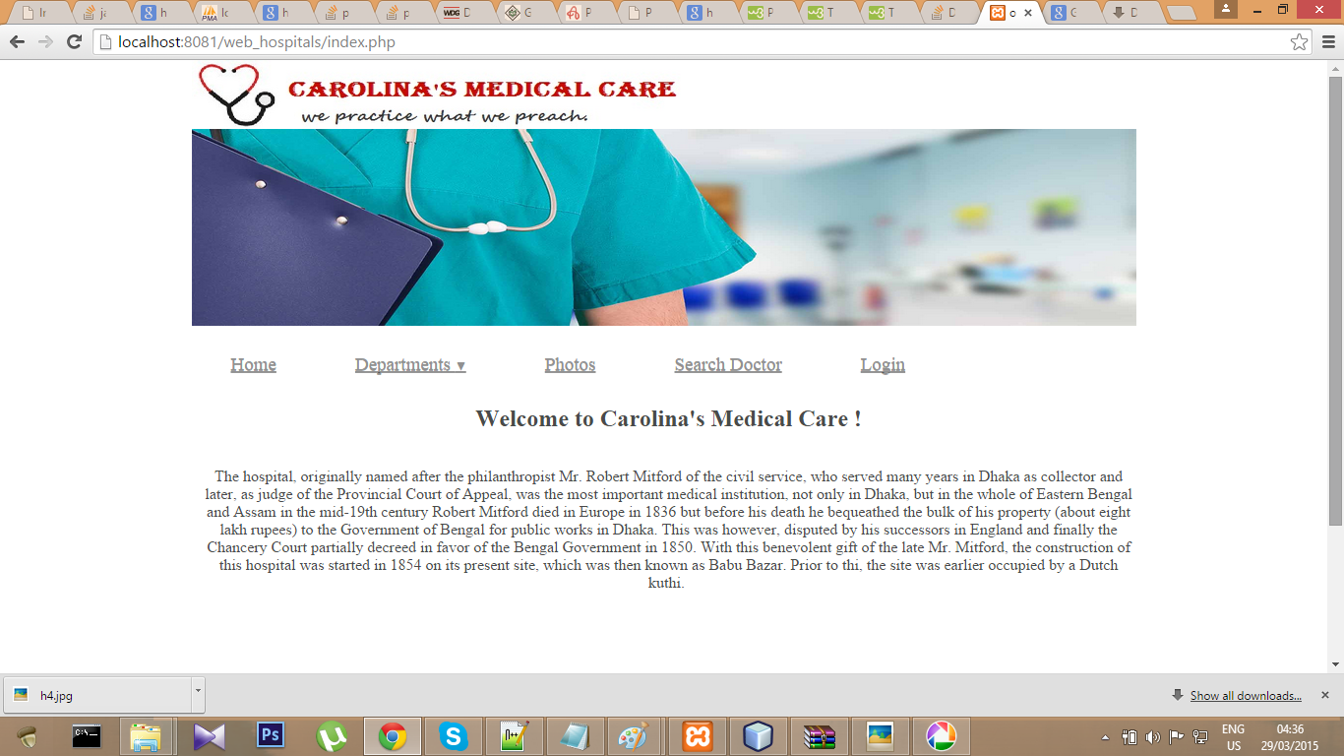
SNAP SHOT OF OUR PROJECT

Slide 9
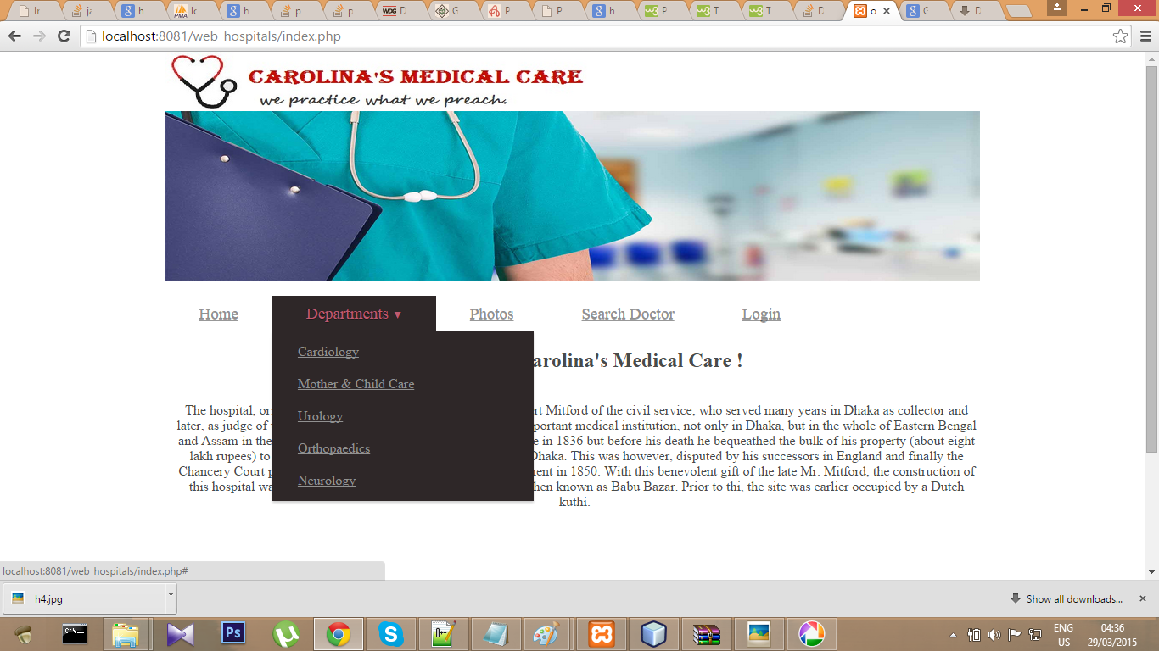
SNAP SHOT OF OUR PROJECT(CONT.)

Slide 10
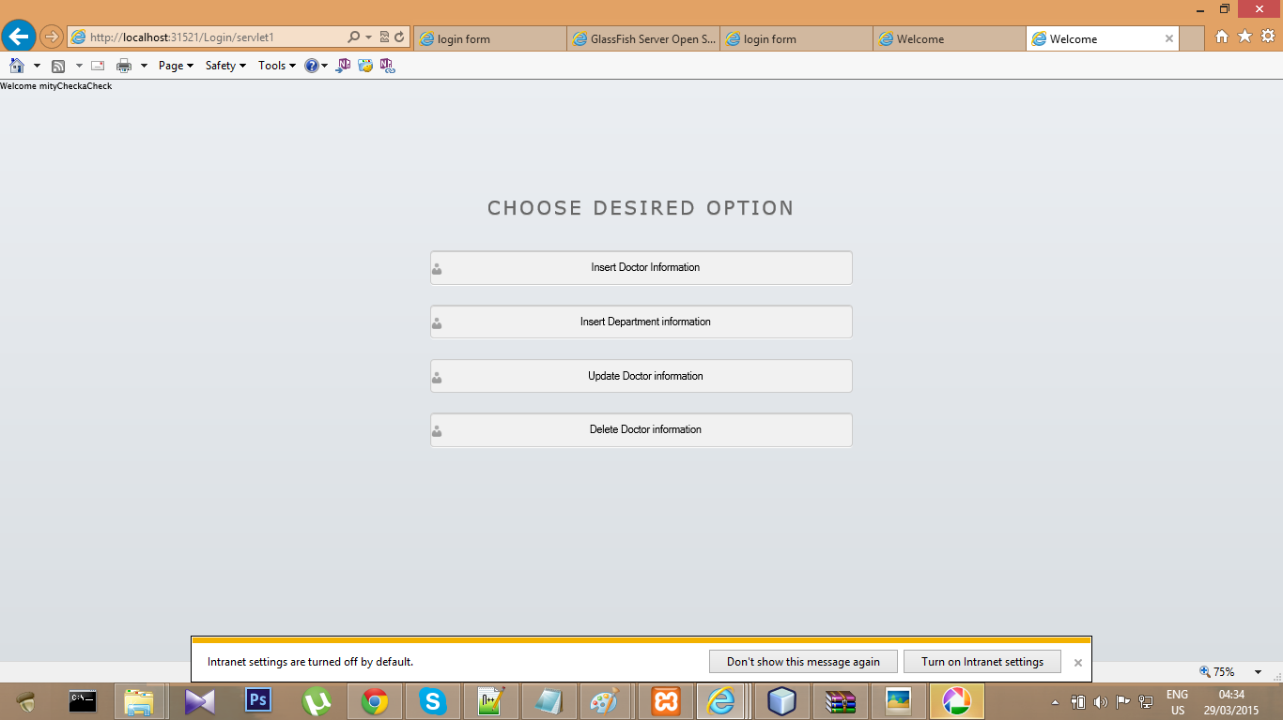

Slide 11
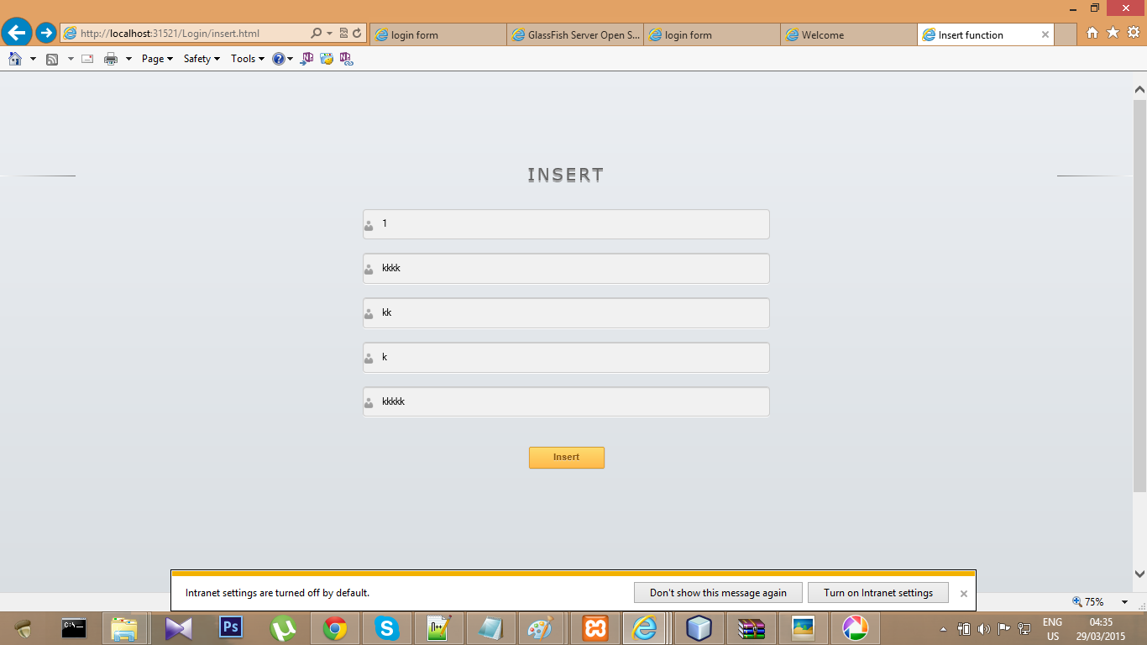

Slide 12
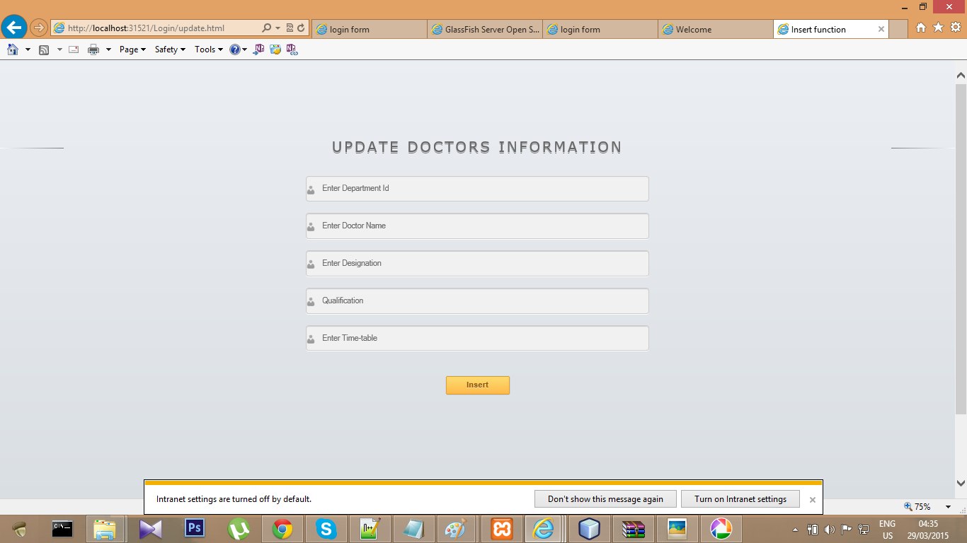

Slide 13
FUNCTIONALITY OF APPLICATION
Anyone will be able to know the depertment of hospital
Patient could know the information of doctor that whic doctor is available at which time

Slide 14
Thank you

